Slide 1
Chapter 2: CSS & CSS 3 Crash Course
HTML5 Video Series
Section 1: CSS Basics Presentation
Section 2: Division & Classes
Section 3: CSS Selectors & Styling
Section 4: Advanced CSS

Slide 2
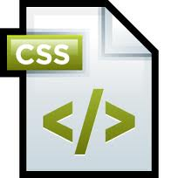
What Are Cascading Style Sheets?
CSS is a “stylesheet” language that is used to describe the presentation semantics of a document that is written in a “markup” language such as HTML
HTML5 Video Series
CSS was created to separate the formatting and design from
the markup or content of the document
The CSS specifications are maintained by the
World Wide Web Consortium (W3C)

Slide 3
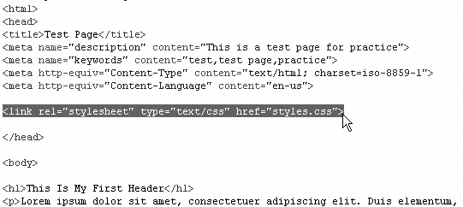
Linking An External Stylesheet
The following syntax is used to link a stylesheet to an html document
HTML5 Video Series
<link rel="stylesheet" href="path/to/file.css" type=“text/css”>
This must be placed in the <head> of the HTML document
The attributes can be in any order
The “type” attribute is not required

Slide 4
<div> and <span> Elements
<span> and <div> elements are used for generic
organizational or stylistic applications
HTML5 Video Series
No specific meaning
<div> is block-level
<span> is inline-level
Id and class attributes
<div> and <span> most commonly are used with class or is attributes.
Syntax for this is…
<div id=“header” class=“space anotherclass”>
<!—your code for the header div→
</div>

Slide 5
CSS Syntax
From the html file we define our id and class…
<div id=“header” class=“space anotherclass”>
<!—your code for the header div→
</div>
HTML5 Video Series
From the css we define the styling for the id and class…
#header{
width:800px;
height: 100px;
background:#000;
}
.space{
margin-bottom:10px;
}

